Slide 1

Foreground Masking using GMM
Supervised By:
Dr. Alaa Hamdy
Presented By:
Youssef George Fouad 19P9824
Kerollos Wageeh Youssef 19P3468

Slide 2
Contents of this template
You can delete this slide when you’re done editing the presentation
Fonts | To view this template correctly in PowerPoint, download and install the fonts we used
Used and alternative resources | An assortment of graphic resources that are suitable for use in this presentation
Thanks slide | You must keep it so that proper credits for our design are given
Colors | All the colors used in this presentation
Icons and infographic resources | These can be used in the template, and their size and color can be edited
Editable presentation theme | You can edit the master slides easily. For more info, click here
For more info: Slidesgo | Blog | FAQs
You can visit our sister projects: Freepik | Flaticon | Storyset | Wepik | Videvo

Slide 3
Table of contents
Introduction
Implementation
01
02
Experiment and Results
Comparison with Classic Methods
03
04
What is the project about.
How we made it work.
Testing our code and measuring the results.
GMM vs Others.

Slide 4
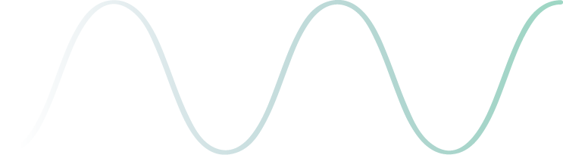
Problem Definition
Foreground detection in video streams.
Distinguishing background and foreground objects.
Dynamic scene changes.

Slide 5
Project Steps
1- Implement GMM
2- Apply GMM on image sequence.
3- Test Results using numeric metrics.
4- Compare with other methods.

Slide 6
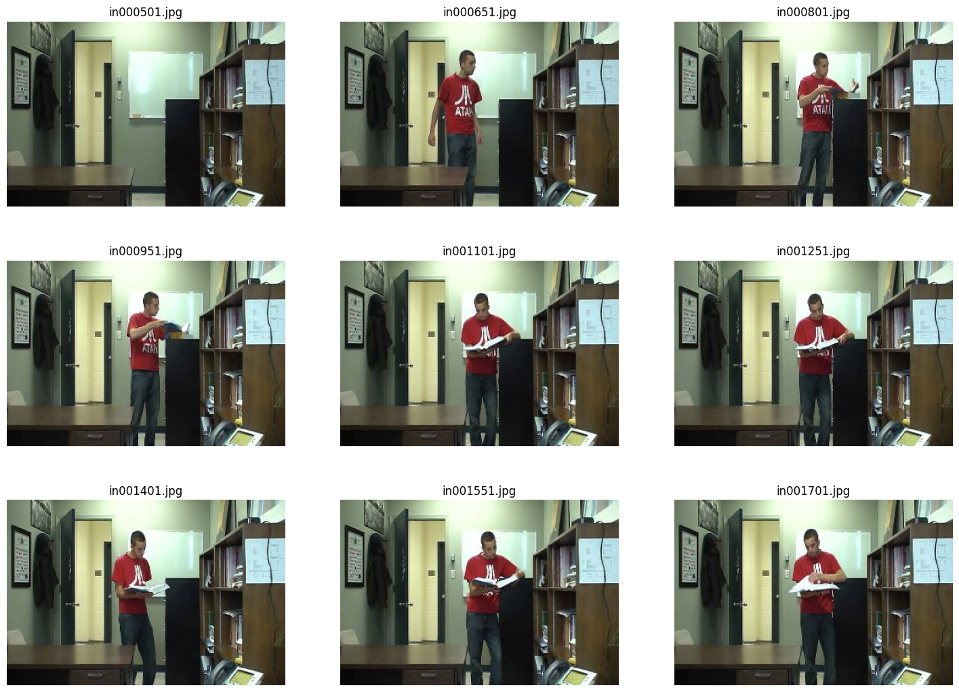
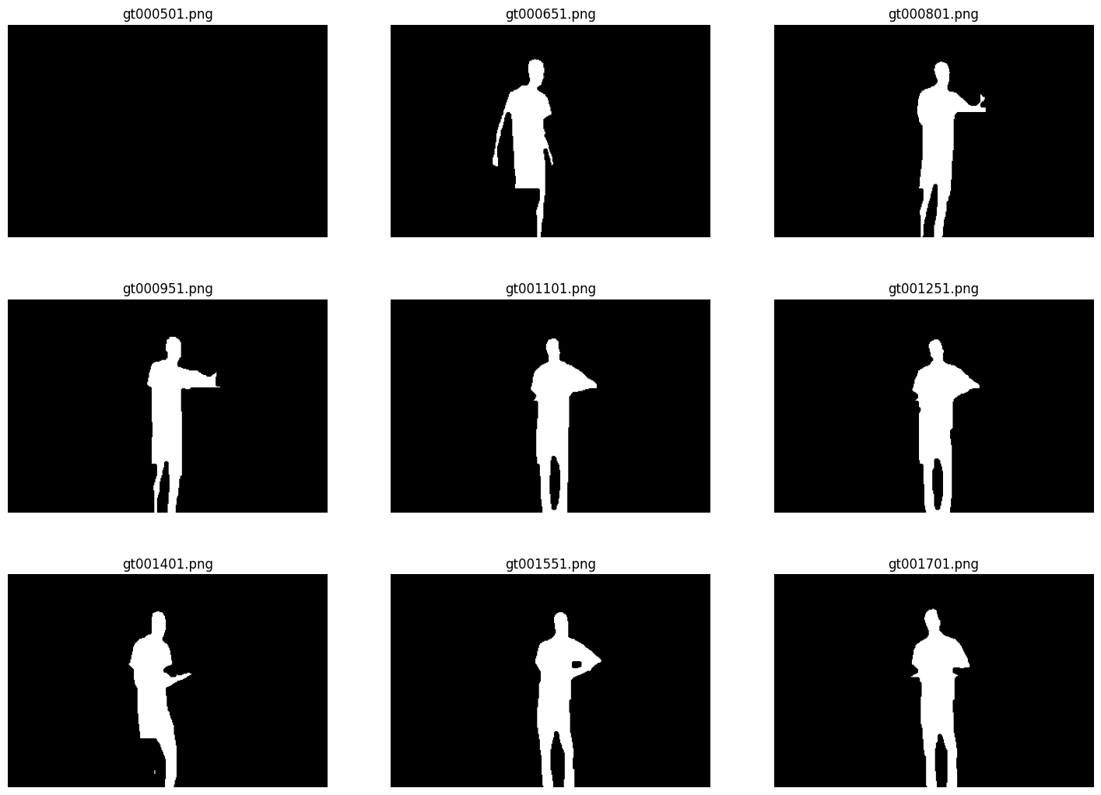
Dataset2012 Samples
Baseline Category
Dataset from www.changedetection.net/

Slide 7
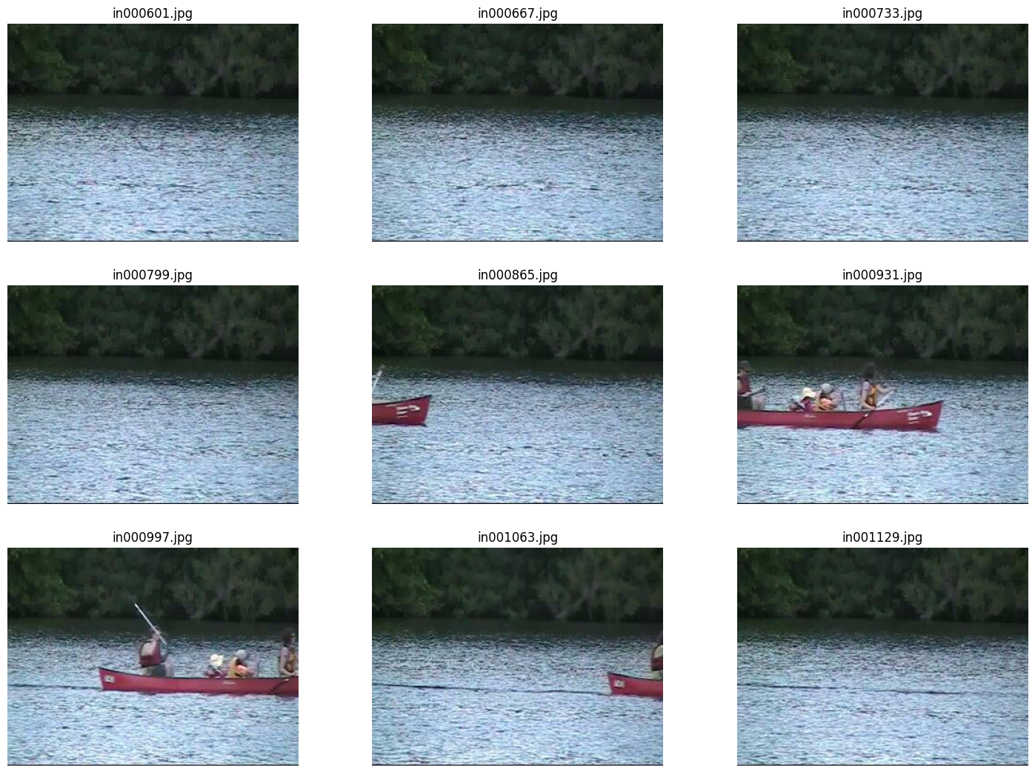
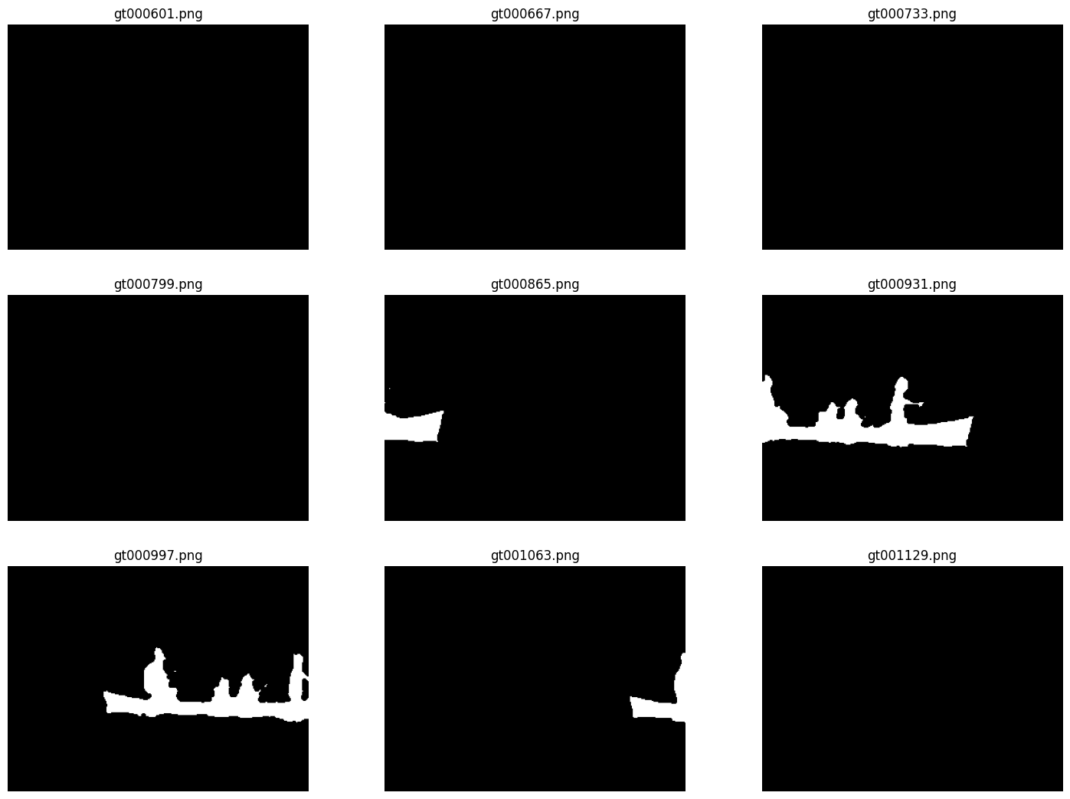
Dataset2012 Samples
Dynamic Background Category
Dataset from www.changedetection.net/

Slide 8
GMM Implementation
Adaptive GMM
Initialize Parameters
Save Image
6
1
Check If Foreground
5
2
Check Match Distributions
Order Distributions
Update Parameters
4
3

Slide 9


Classical Method
Adaptive Averaging
Choose forgetting factor $α$
Save Image
6
1
Check If Foreground
5
2
Update x
$$x_{t}={\left(1−α\right)∗x}_{t−1}+α∗x_{t}$$
Apply Threshold
Get Absolute Difference
4
3

Slide 10
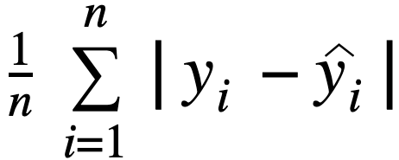
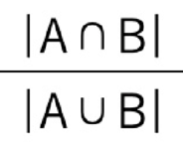
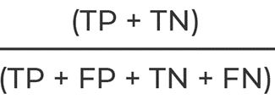
Evaluation Metrics
Mean Absolute Error (MAE)
Intersection Over Union (IOU)
Accuracy

Slide 11
GMM Visual Results

Slide 12
Classical Visual Results

Slide 13
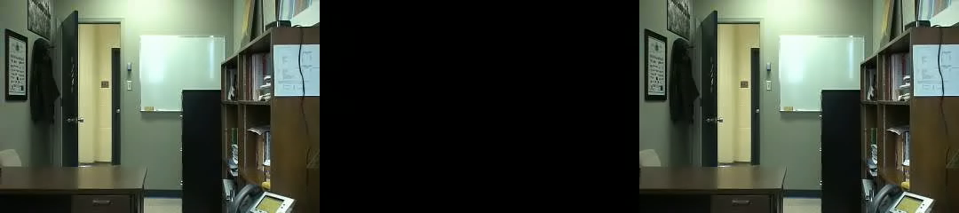
Applying Evaluation Metrics on GMM

Slide 14
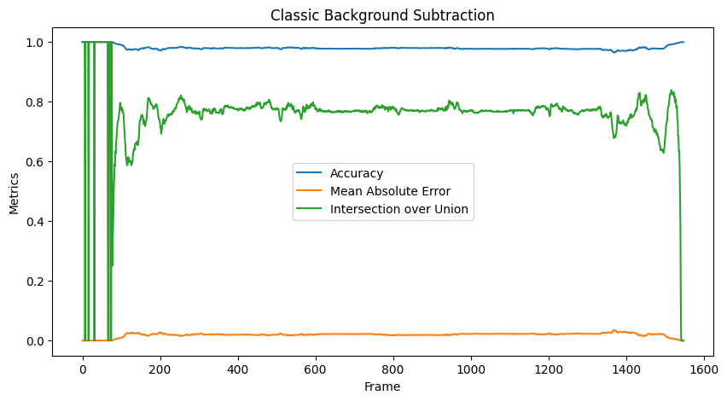
Applying Evaluation Metrics on Classical Method

Slide 15
Thank You

